Slide 1
DDE Exploits in an APT Botnet Attack
Christopher Morcom

Slide 2
Overview
Previous Progress
Current Progress
Attack Implementation
Testing
Evaluation of Attack
Potential Updates
Questions

Slide 3
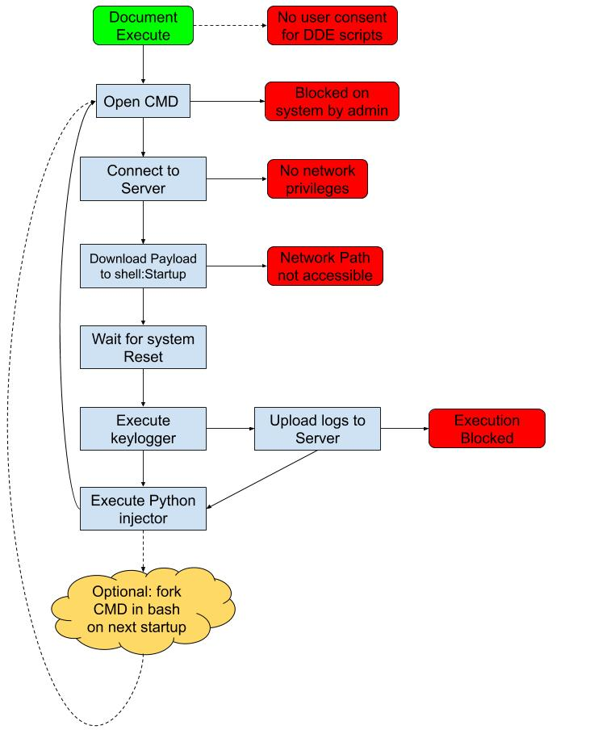
Previous Progress
Created Script for DDE in MS Office
Able to DoS Win10 on login
Unreliable Apache server
Created Keylogger
Created Script to generate malicious payloads
Unable to infect documents without a template

Slide 4
Current Progress
Using HeidiSQL and MariaDB
Payload binaries stored in DB
Upgraded to PowerShell scripts through CMD
Keylogs sent to DB Table of keylogs
Infection guarantees multiple attack vectors
Need to make standalone executables

Slide 5
System Specs
i7 8700k @ 4.6 GHz
32 GB RAM @ 3200 MHz
Windows 10 Fall 2018 Update
Python 3.7
MariaDB (HeidiSQL)
PowerShell v1.0
CMD
VM VirtualBox (4GB RAM) (For Testing)

Slide 6
Document Execute
No user consent for DDE scripts
Download restrictions
Open CMD (to open Powershell)
Blocked on system by admin
Connect to Server
No network privileges
Run document Infector
Download batch infector to shell:Startup
Wait for system Reset
Run DoS Attack
Run batch to run powershell downloader
And batch executor
Wait for system Reset
Run Keylogger
Install appropriate python libraries
Update Payloads

Slide 7

Testing (Initializer)
Initial Script
Secondary Script
* executor executes python scripts.
** scripts can be obfuscated if compiled
Notes:
Python libraries installed for this simulation
If i had a compiled python file (.pyc) things would be better

Slide 8
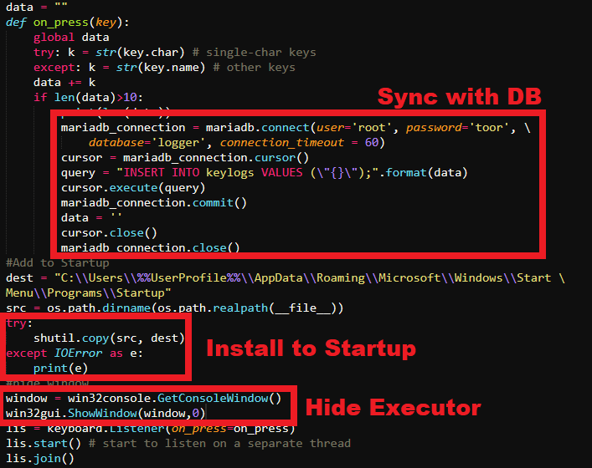
Testing (Keylogger)
DataType in DB is LONGBLOB
Logger is obfuscated
Updatable to send up to k-chars per log
If cannot download to startup, edits registry
Thread does not stop! (kill random thread + self on quit)
Shows signs of SPECTRE vulnerability
Notes:
Connection with DB closes after every log send query
Can scan up to k-keys before sending
Executor is hidden and is a low-priority service hijacking PowerShell

Slide 9
Testing (DoS)
START \min
%0|%0
Process forks and grows exponentially. Simply crashes the computer.

Slide 10
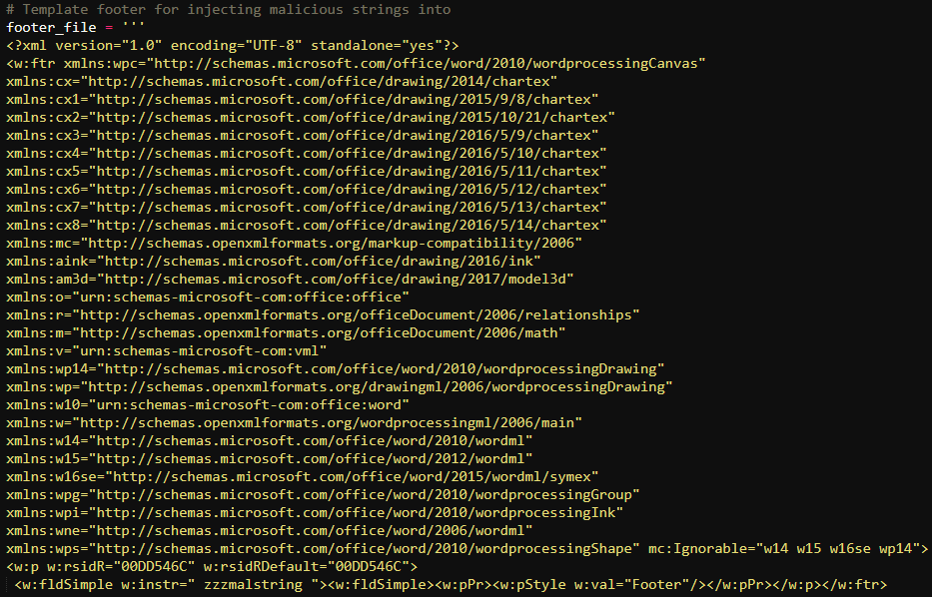
Testing (Document Infector)
Scans for next editable word document
Opens excel or word doc as an XML
Scans for footers to inject
Works in May 2016 versions or earlier
Injects customized payload into document
Footers and injector created by: https://github.com/True-Demon/DeeDee

Slide 11
Evaluation
The Good:
The Bad:
Attack can be updated with any payload
Connections between client and server (controller) are not persistent
Extremely infectious
Executing processes are linked to system processes
Bots are easy to control via server or metasploit (sub) shell
Initialization is extremely unlikely
Connections are easily found and stopped.
Killing the connection kills the bot forever on the host
Ingress has been patched, making the attack slightly redundant
Patches for Powershell and CMD are imminent
SO WHY IS THIS RELEVANT?
Notes:
It’s not really relevant.
Identifies some exploits that can be carried out at the user-level upon successful ingress
A more sophisticated, hybrid botnet, with better obfuscation would be hard to break
Obfuscation can be simple (like hijacking a process). It is not a requirement if there is a lot of persistence either (like infecting every system file).

Slide 12
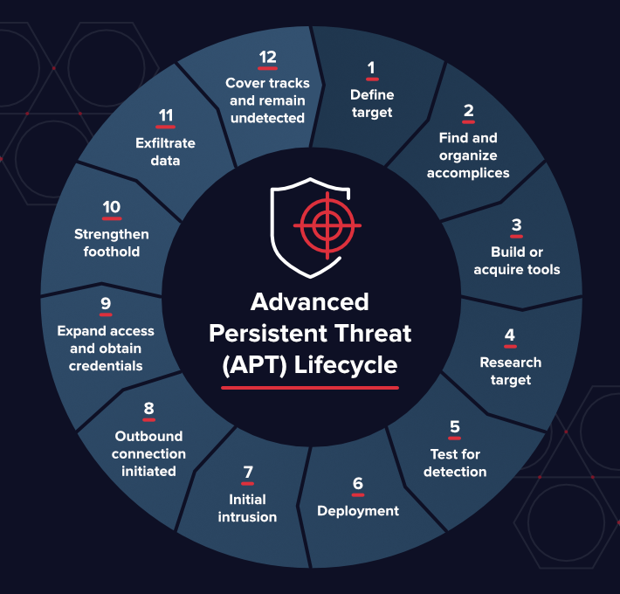
Potential Updates
Obfuscation
Network-Traceable
Expand to Mac/Linux
Only works on Windows
Patched in May Update
Use other tools to make infection faster and more reliable
Ingress could be better
Finding other ways to hack the system
Notes:
Actually, linux has more tools than windows for this
Using chromedriver to scan webpages on host machine and get data and post to server

Slide 13
Questions?

